Slide 1
Facial recognition and detection
Student Name: Andre Freeman
Student ID: 410521320
Student Name: 黃嵩育
Student ID:410321306

Slide 2
Problem Description
The class of 106 wishes that they can create a mechanism that can identify face from a collection of faces of everyone in the class/group. N. B. These faces are not all (direct) frontal faces but are sometimes skewed, off to a side and with facial emotions.

Slide 3
System/algorithm description
First we start by detecting the list of images that we going to used to train the algorithm.
From the list we can load each image one by one. Also a mechanism is set in place so that we can detect if an image is a next epoch of the same person or if it is a new persons image.
Example s01_01.jpg and s01_02.jpg is images for the same person where s02_01.jpg is for a next person.
From each image we utilized the following:
Face predictor:
shape_predictor_68_face_landmarks.dat
Face detector:
dlib.get_frontal_face_detector
From the predictor and the face detector we can generate 68 (x,y) points for each face.
Generalize the 68 (x,y) points to all between values of 0 and 1.

Slide 4
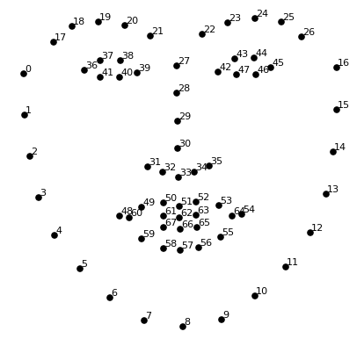
System/algorithm description
The 68 (x,y) point landmark is of the form illustrated below
After generalization the points will be in the form.
x | y
0.01105202654 | 0.12477544545
0.12584525845 | 0.24548598956

Slide 5
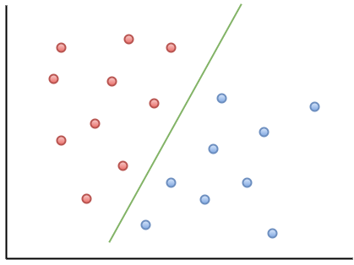
System/algorithm description
For 68 (x,y) points system we set up 68 support vector machine (SVM)
Each SVM would be use for exactly one point of the 68 points. Each SVM would support two features (x,y) as shown below.

Slide 6
System/algorithm description
Set up the data structure necessary for training the 68 (x,y) points
Create a 3 dimensional array for L[i] where the index ‘i’ the would indicate the particular point of the 68 points. (i.e. L[0] would contain a 2-D array of all the (x,y) points pertaining to the 0 point on the face and so on.
Train the 68 SVM
Detect the 68 points from the face we would try to recognize/identify
Use the SVMs predict function to gain the result for each individual SVM.
Since there are 68 SVMs there would be 68 answers.
Each SMV undergo voting
Tally up the answers. Note the person with the highest tally value
The identified person would be the person with the highest vote.
Display a sureness percentage of it being that particular person.

Slide 7
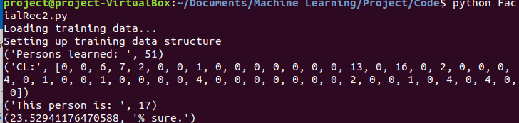
Experimental Results
##The actual answer is 5

Slide 8
Conclusion
From results generated from the algorithm we can not safely assume that this is not a very accurate way of predicting face.
Not enough precision and accuracy of the data types use in the training data structure
One must also indicate allowing multiple different emotions, skewed and slurred faces also gave rise to noise/interference and overlapping of classes that alter the accuracy of the algorithm greatly.

